Slide 1
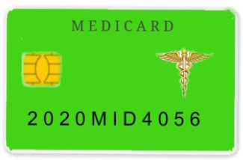
MEDICARD
Student 1 (191EC176 - KALAIARASI M)
Student 2 (191EC163 - JAISRI V)
Student 3 (191EC287 - SUBHA R)

Slide 2
Abstract
There is a need for proper database management in all fields and medical field it is very important because it deals with the life of people’s.
Medicard is a device which is used to access the medical data which are stored in the cloud database
All the medical database are stored in the cloud and it is accessed under 3 modes of operation
This is very useful in the identification of a fast spread disease in short period of time.

Slide 3
Problem Statement Addressed
Maintaining sequential order of medical reports and carrying it is the major problem.
Improper medication at emergency cases without knowing the drugs they are consumed also lead to loss of lives.
There is no awareness about the fast spreading disease because of late analysis of the disease.

Slide 4
Existing Solution to the Problem Addressed
Existing techniques : RFID storage, hospital database.
Literature survey : In most cases, information is only restricted to medical authorities such as chairman, doctor.This may lead to malpractices, illegal medical practices.
Proposed works : Medical data are stored in cloud database. Medicard and fingerprint is used for authentication. By using the pharmaceutical database,we will know about fast spreading disease and we can take prevention methods and aware people about that disease.

Slide 5
Proposed Solution to the Problem Addressed
Emergency- in this mode the doctor can access the medical report without the patient. In the emergency situation the medical reports can be viewed and necessary treatment can be done. Non editable mode
Non-emergency- in this mode of operation the doctor along with the patient can access the medical report. The updation can be done in this mode of operation.
Pharmaceutical and scanning centers- in pharmaceutical sites the prescribed drugs can be viewed and help in the supply. In scanning centers the medical reports can be uploaded.

Slide 6
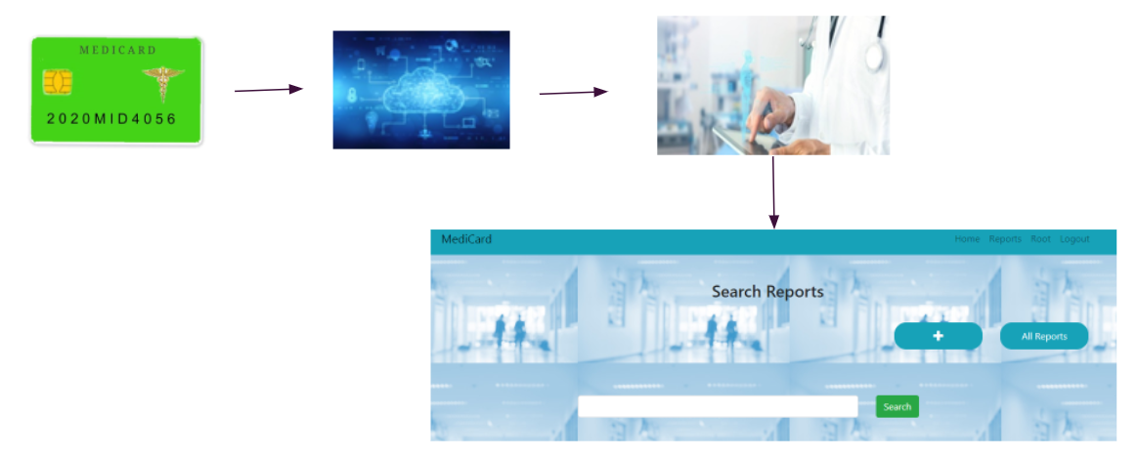
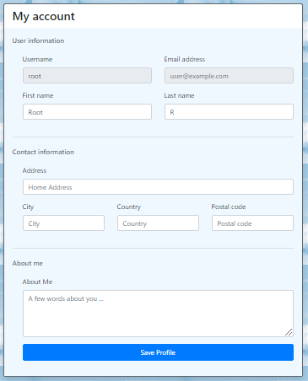
Project Work Plan

Slide 7
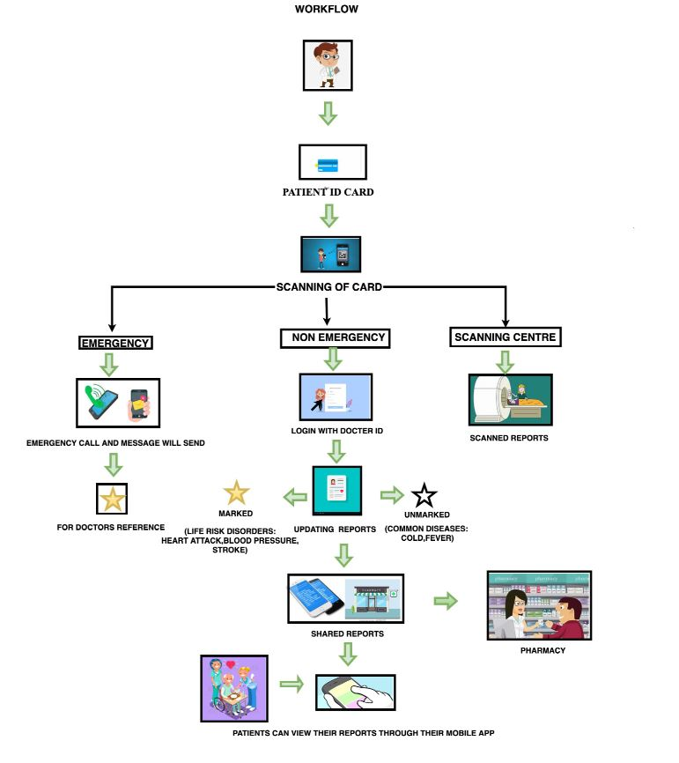
Flow Chart

Slide 8

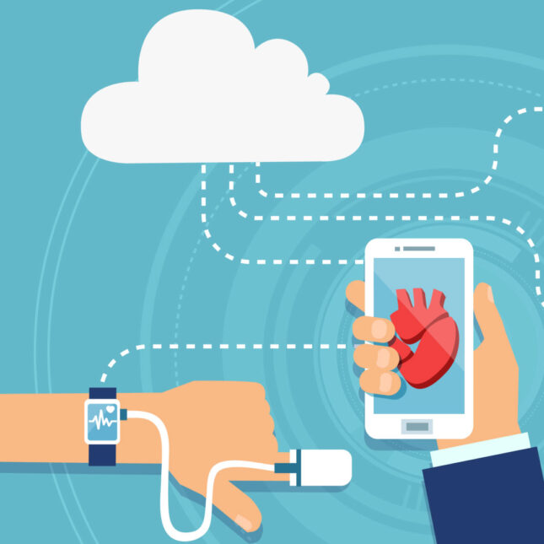

Effective utilization of the Modern Tool & Cloud

Slide 9

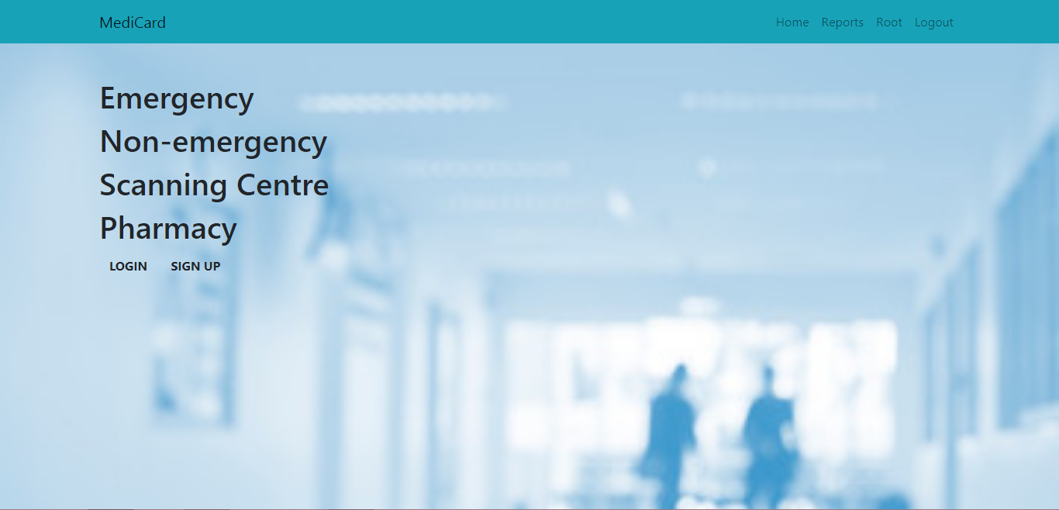
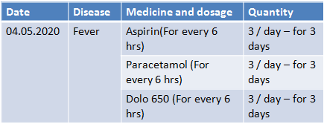
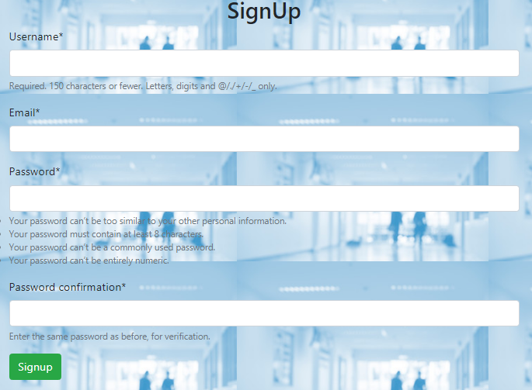
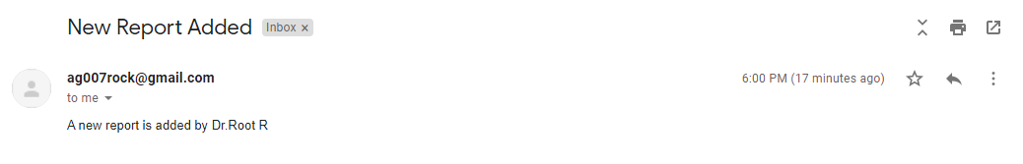
Prototype & Sample Output

Slide 10
Analysis of Results & Discussions
Proper diagnosis and establishing a standardized in medical databases can be achieved.
It should be monitored by Central organization for better monitoring and control.
By implementing this so medical crime rate can be reduced, proper database management is achieved, easy identification of fast spread disease can be noted.
On analysing the pharmacy database, the fast spreading disease can be identified. Hence the preventive measures can be taken at rapid speed.
Network is an dependent factor.

Slide 11
Cost Benefit Analysis (List of Components / Service Used)
S.No | Component Name | Specification (IC number or Range or Value) | Unit Cost | Total Cost
1. | RFID Tag and scanner | - | 1 | Rs 200/-
2. | FingerPrint sensor | - | 1 | Rs 1500/-
3. | Cloud Storage | For a month | 5 TB | Rs 150/-
4. | Arduino UNO | - | 1 | Rs 400/-

Slide 12
References
M. K. Shahin, "Wireless communication and RFID based handheld database and medical diagnostic system," 2014 Cairo International Biomedical Engineering Conference (CIBEC), Giza, 2014, pp. 6-9, doi: 10.1109/CIBEC.2014.7020922.
Yang Jin, Tang Deyu and Zheng Xianrong, "Research on the distributed electronic medical records storage model," 2011 IEEE International Symposium on IT in Medicine and Education, Cuangzhou, 2011, pp. 288-292, doi: 10.1109/ITiME.2011.6132041.

